Slide 1


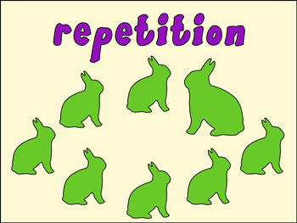

Introduction To Programming
Repetition Structures
SoftUni Team
Technical Trainers
Software University
http://softuni.bg

Slide 2

Table of Contents
What is a repetition structure?
How can they be useful to us?
What types of repetition structures does C# support?
What does every repetition structure need to have?
Different ways to make repetition

Slide 3
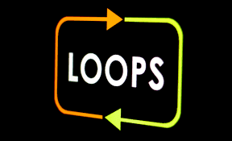
What is a repetition structure
Repetition structures, or loops, are used when a program needs to repeatedly process one or more instructions until some condition is met
can help us execute one or more statements up to a desired number of times
Executing a repetitive action trough a loop helps us avoid code repetition

Slide 4
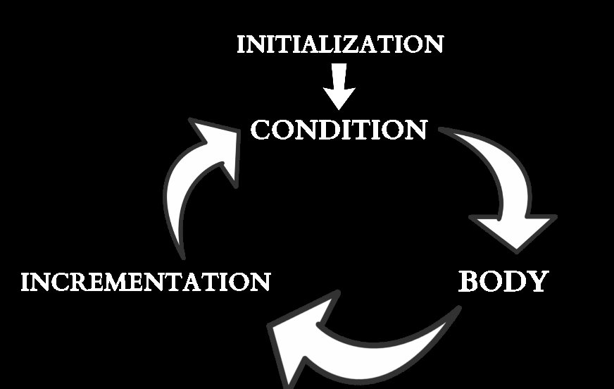
Elements of a loop
Constructing a loop requires four elements:
Initialization
Condition
Body
Incrementation / Actualization
Different loops implement these
elements in a different way.

Slide 5

Loops

Slide 6
While loop
The while loop repeatedly executes a block of statements until a specified Boolean expression evaluates to false
Initialization
int number = 20;
int factorial = 1;
while(number > 1)
{
factorial = number * factorial;
number--;
}
Console.WriteLine(“Factorial of 20 – “ + factorial);
Condition
Body
Incrementation

Slide 7
While loop Example
This is a simple representation of the while loop
False
START
X = 10
X < 20
True
OUTPUT X
X = X + 1
STOP

Slide 8
Do - While loop
The do-while loop is almost the sa
e as the while loop except it evaluates its condition after
will always execute the block of code at least ONCE
Initialization
int number = 1; //this should break the loop
do
{
Console.WriteLine(“I will loop at least once!”);
number--;
}
while(number != 1);
Console.WriteLine(“Number is now – “ + number);
Body
Incrementation
Condition

Slide 9
Do - While loop Example
This is a simple representation of the while loop.
True
START
X = 10
OUTPUT X
X = X + 1
X < 20
False
STOP

Slide 10
For loop
The for loop combines the three elements of iteration into a more readable code
the initialization expression
the termination condition expression
the counting expression
Initialization
Condition
Incrementation
for(int i = 0; i < 10; i++)
{
Console.WriteLine(“Current number is – “ + i);
}
Console.WriteLine(“Loop has finished successfully.“);
Body

Slide 11
Foreach loop
The foreach loop is useful for iterating through the elements of a collection
Initialization,
Condition,
Incrementation
int[] numbers = new int[]{ 1, 2, 3, 4, 5, 6, 7, 8 };
Int[] secondaryNumbers = new int[8];
foreach(var number in numbers)
{
Console.WriteLine(“The current number is – “ + number);
secondaryNumbers[number - 1] = number;
}
Console.WriteLine(“Foreach loop has finished!”);
Body

Slide 12

Recursion

Slide 13
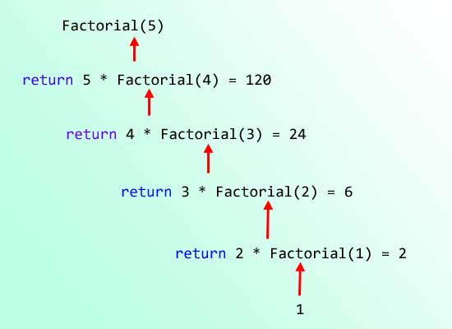
Recursion
Recursion is the repeated application of an operation, which is performed by the operation initiating the execution of itself
public static int Factorial(int number)
{
if(number == 1)
{
return 1;
}
return number * Factorial(n – 1);
}

Slide 14
Recursion
To construct a recursive method, we must have:
base case – the terminating condition, and the bottom of the recursion.
recursive case – the step-forward into the algorithm – the recursive call.
Terminating condition
public static int Factorial(int number)
{
if(number == 1)
{
return 1;
}
return number * Factorial(n – 1);
}
Base Case
Recursive Case

Slide 15

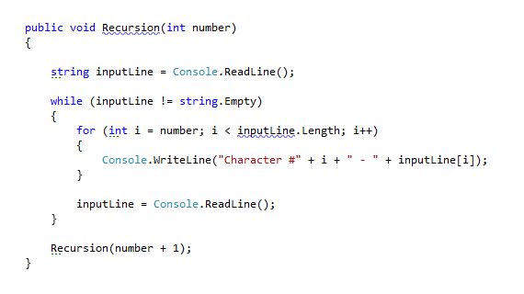
Live Demo

Slide 16
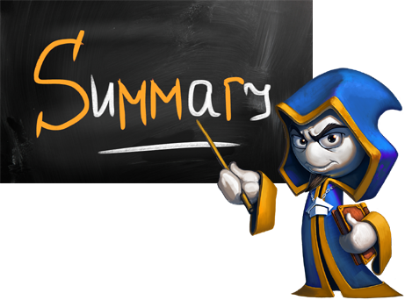
Summary
What are loops?
What do we need to make a loop – the four elements of a loop
Differences in the syntax and behavior of different loops
What is Recursion?
What is necessary to have, when making a recursive algorithm

Slide 17








Questions
https://softuni.bg/courses/javascript-applications/

